Slide 1


Python Fundamentals
Innovation Masters
Day 9

Slide 2
Today’s Agenda
Showing to class the turtle homework
Learning how to increment/decrement for loop
Making a string reverser program
Game show
Tech Talk

Slide 3
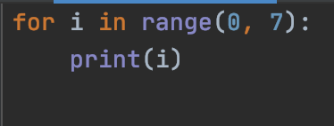
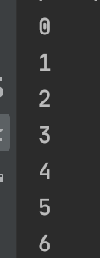
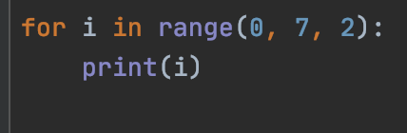
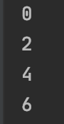
For loops with increment/decrement

Slide 4
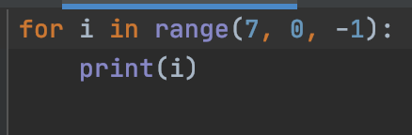
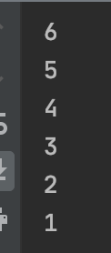
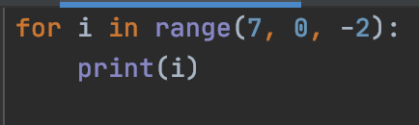
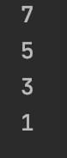
What about decrement?

Slide 5

String Reverser
Takes a string as an input and returns the reversed version of the string
Input: Proggramming
Output: gnimmarggorP

Slide 6
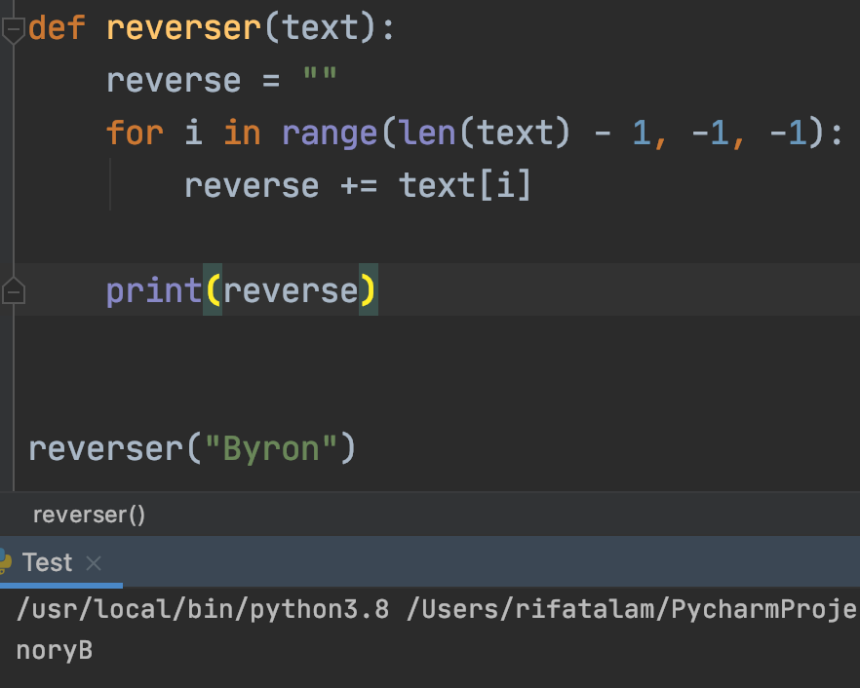
Solution

Slide 7
Game Show
Who Wants To Be
A Millionaire
Computer Scientist

Slide 8
Rules
3 rounds
Rapid Fire Round
Memory Jogger Round
In and Out Round

Slide 9
Rules Continued
Whoever buzzes first, gets to answer first.
If the answer is wrong, someone else can get the point by answering.
2 points each question. Players can share points.
Take your time. Buzz only when you are ready to answer.
No deduction for wrong answer.
1-point deduction if you delay after buzzing.

Slide 10
Rapid Fire Round
4 choices for each question
No need to explain anything.
Simply buzz and pick the option you think is right.
If you think more than 1 is right, pick best option.

Slide 11
Rapid Fire-1
What programming language are we learning?
Java
Scratch
PyCharm
Python

Slide 12
Rapid Fire-2
What is hardware?
The central processing unit
All the physical components of a computer
Wear and tear of metals
The steel body of a computer

Slide 13
Rapid Fire - 3
What are binary numbers?
Number that hardware understands
Random combination of 1’s and 0’s
Combination of 1’s and 0’s that are converted to “HIGH” and “LOW” voltages respectively.
Similar to decimal system.

Slide 14
What is GUI?
What runs the code.
The graphical user interface that presents the program in a visual way.
A gaming environment.
The buttons or text fields on the screen to take user input .

Slide 15
What is computer science?
Science of making computers.
Study of computers, mainly focusing on the software aspect of computers.
Same as computer engineering.
A very hard subject.

Slide 16
Which is the first computer?
Macbook pro
Dell Inspiron
Abacus
IBM 5150 PC

Slide 17
What is a String?
A thread of nylon.
A thin long tube that cools the computer.
A collection of characters that represent text.
A type of a method.

Slide 18
What does the String.count method do?
Counts all the integers in the parameter.
Counts how many times a character/substring occurs in a string.
Counts how big a string is.
Counts how many characters are in the string.

Slide 19
What do I study?
Mathematics
Computer Science
Mechanical engineering and computer science
Applied math and computer science

Slide 20
What is concatenation of strings?
Subtracting strings
Adding strings.
Multiplying strings.
Repeating strings.

Slide 21
When we call a method, we need to put the ___ in the parentheses, if there are any.
Int
Parameter
Perimeter
Text

Slide 22
A method needs to have parameters.
True
False

Slide 23
A method always needs to return a value.
True
False

Slide 24
If/else statements are called
Preconditional statements
Decision-making statements
Argumentative statements
Conditional statements

Slide 25
Why comment?
Easy to remember what the methods did
Easy for other people to understand code
Gives Description for the methods and variables
All of the above

Slide 26
Memory Jogger
Congratulations on passing Rapid Fire
Now we will start the next round

Slide 27
Memory Jogger Rules
There will be no options to choose from.
Just use short phrases or a few sentences to answer the questions accordingly.
If someone tries but explains half, another student can complete the answer, and both get 1 point each.

Slide 28

What is machine language?

Slide 29

What does the print() method do?

Slide 30
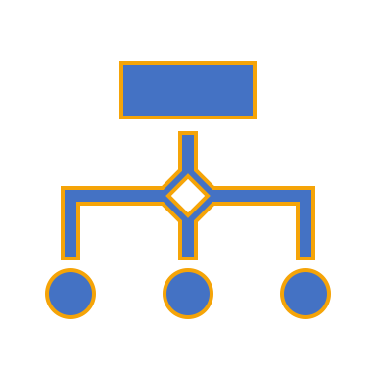
What are the three components of a variable?

Slide 31

What is the general structure for making any program?
Hint: 5 steps
5 points for this question

Slide 32
What is typecasting?

Slide 33
Why do we have to typecast when we take numbers as input from the user?

Slide 34

What are the 3 types of variables we learnt so far?

Slide 35
What is the 4th type of variable that we talked about but did not use in any program?
Bonus question: 1 point

Slide 36
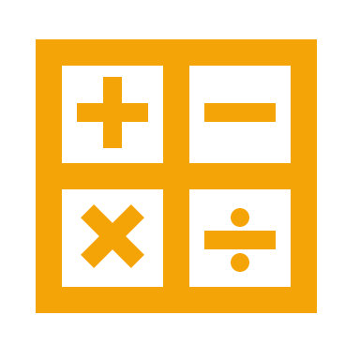
Difference between == and is?

Slide 37

What is the keyword we use when we want to tell python that we are making a method?

Slide 38

What are the 4 components of method definition?

Slide 39
What is the difference between a void method and a method that has a return type?

Slide 40

When might a return type method be useful over a void method?

Slide 41
What is the difference between global and local variables?

Slide 42
Give the syntax of if/else statements and explain how it works?
4 points

Slide 43
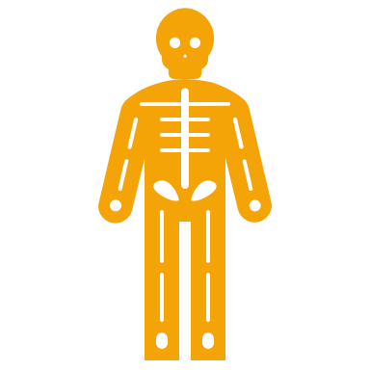
What does the len() method do?

Slide 44
In and Out Round
Here you will be shown screenshots of code.
You have to decide what will be the output or in other words what will happen when the code is run.

Slide 45
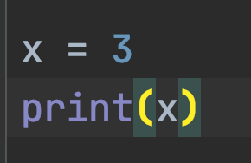
What is the output?

Slide 46
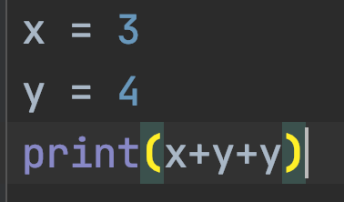
What is the output?

Slide 47
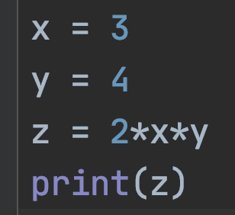
What is the output?

Slide 48
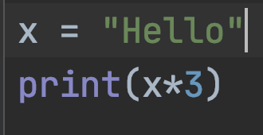
What is the output?

Slide 49
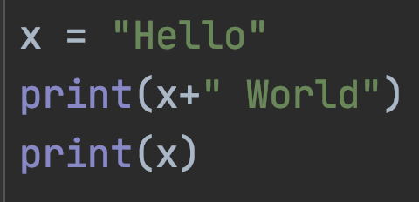
What is the output?

Slide 50
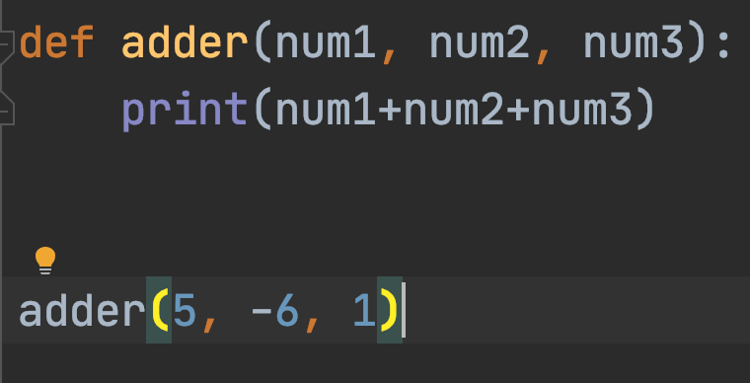
What is the output?

Slide 51
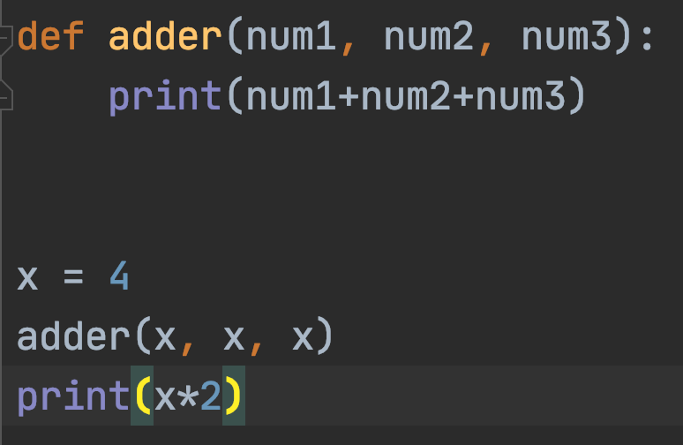
What is the output?

Slide 52
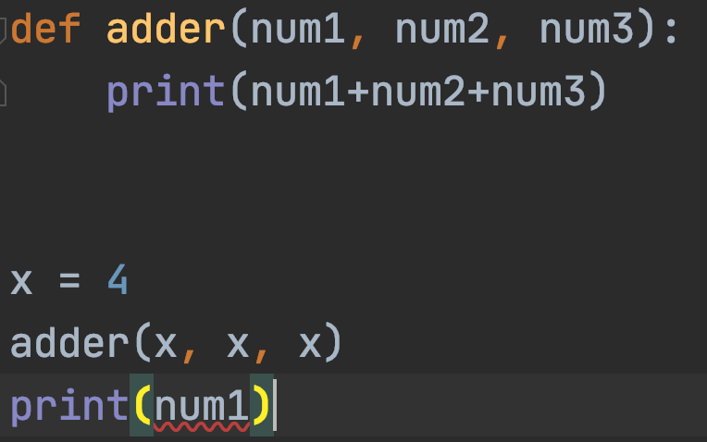
What is the output?

Slide 53
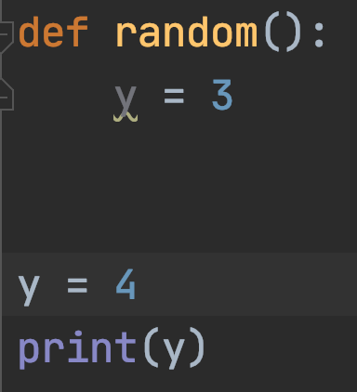
What is the output?

Slide 54
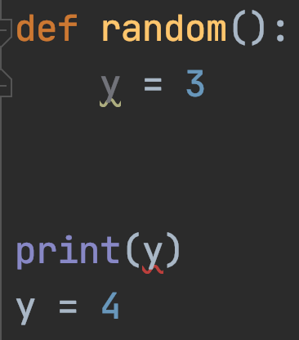
What is the output?

Slide 55
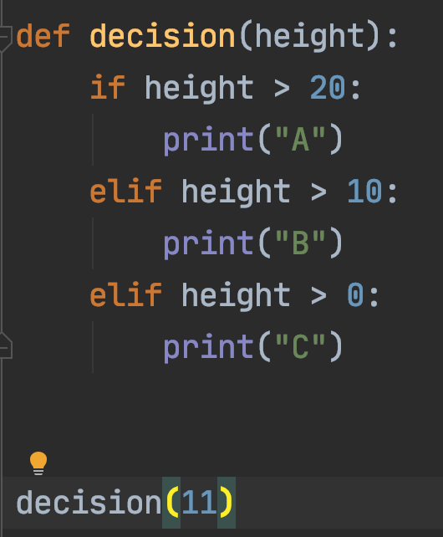
What is the output?

Slide 56
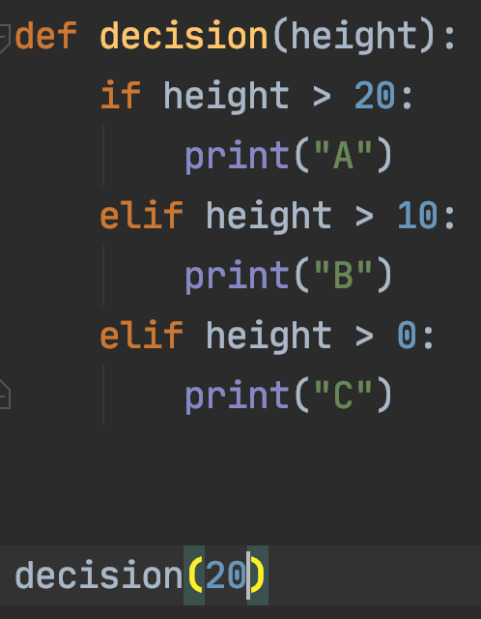
What is the output?

Slide 57
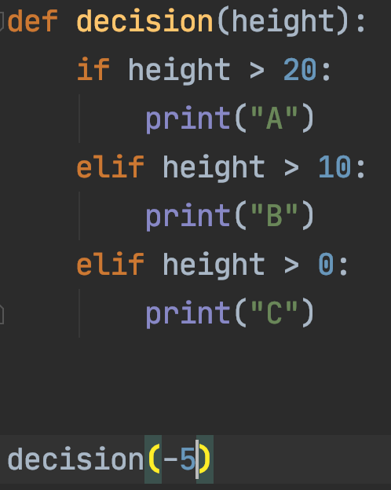
What is the output?

Slide 58
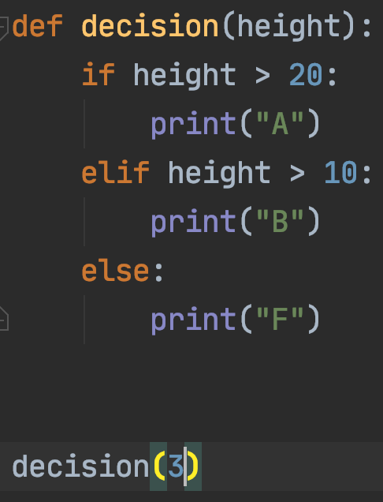
What is the output?

Slide 59
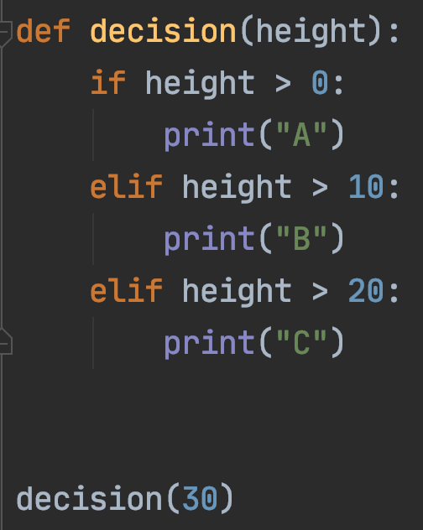
What is the output?

Slide 60
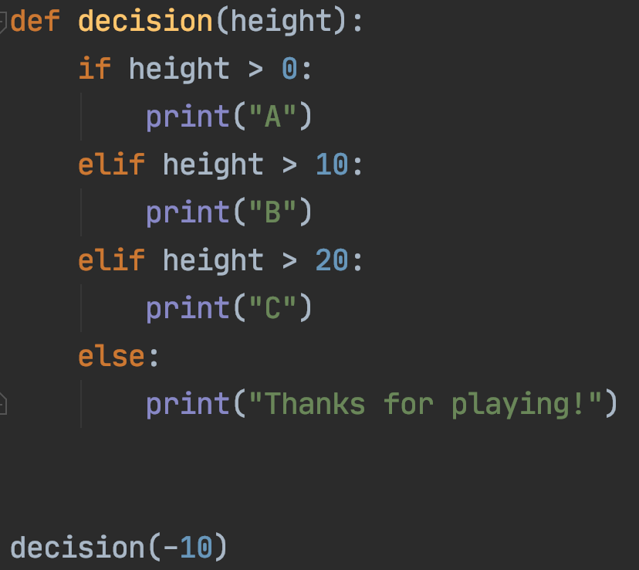
What is the output?

Slide 61
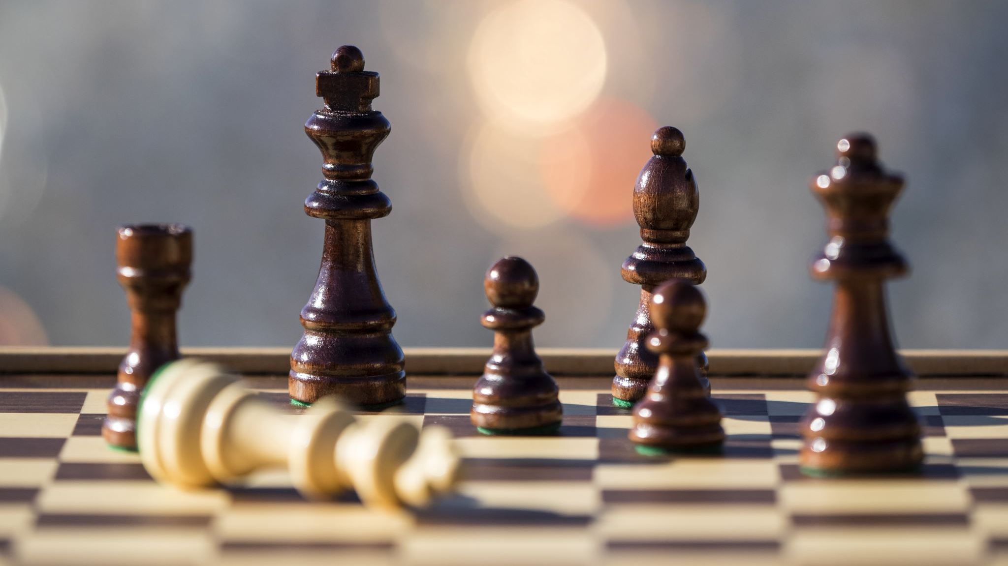
End of Game Show
Hope you had fun

Slide 62
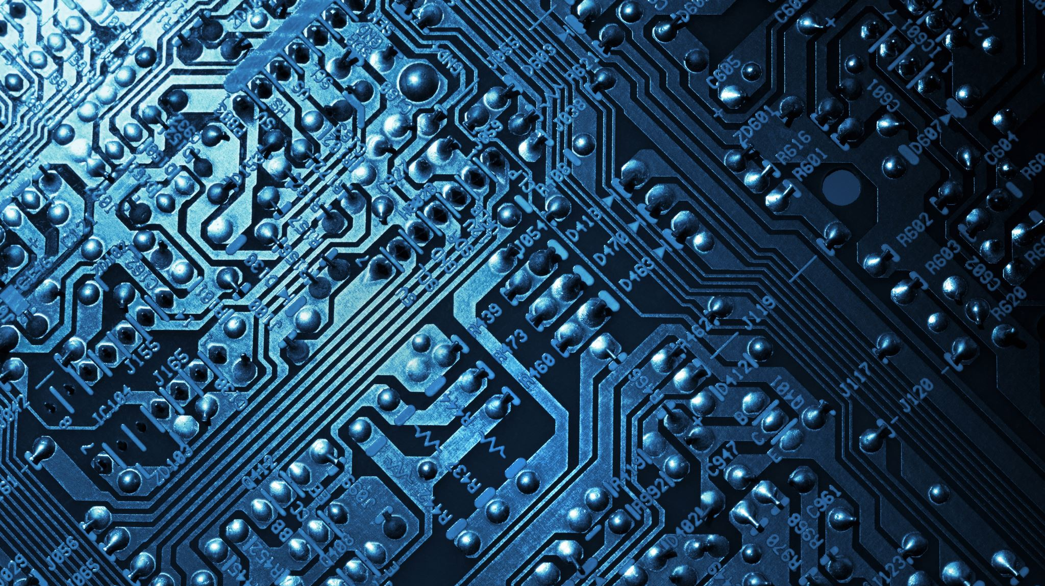
Tech Talk
https://www.youtube.com/watch?v=ck4RGeoHFko
https://www.youtube.com/watch?v=dSu5sXmsur4

